Slide 1


2
Data Types
and
Expressions
C# Programming: From Problem Analysis to Program Design
4th Edition

Slide 2
Chapter Objectives
Examine how computers represent data
Declare memory locations for data
Explore the relationship between classes, objects, and types
Use predefined data types
Use integral data types

Slide 3
Chapter Objectives (continued)
Use floating-point types
Learn about the decimal data type
Declare Boolean variables
Declare and manipulate strings
Work with constants

Slide 4
Chapter Objectives (continued)
Write assignment statements using arithmetic operators
Learn about the order of operations
Learn special formatting rules for currency
Work through a programming example that illustrates the chapter’s concepts

Slide 5
Data Representation
Bits
Bit – "Binary digIT"
Binary digit can hold 0 or 1
1 and 0 correspond to on and off, respectively
Bytes
Combination of 8 bits
Represent one character, such as the letter A
To represent data, computers use the base-2 number system, or binary number system

Slide 6
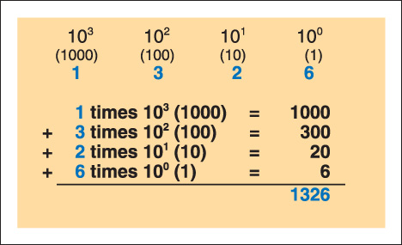
Binary Number System
Figure 2-1 Base-10 positional notation of 1326

Slide 7
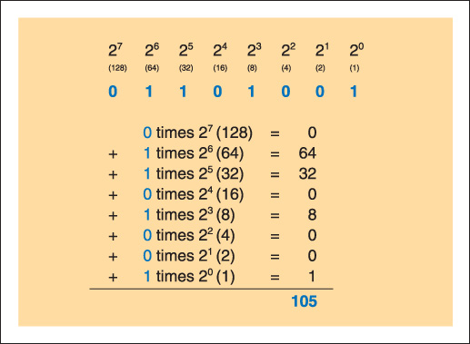
Binary Number System (continued)
Figure 2-2 Decimal equivalent of 01101001

Slide 8
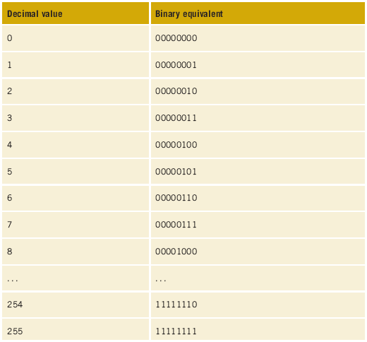

Data Representation (continued)
Table 2-1
Binary
equivalent
of selected
decimal
values

Slide 9
Data Representation (continued)
Character sets
With only 8 bits, can represent 2⁸, or 256, different decimal values ranging from 0 to 255; this is 256 different characters
Unicode – character set used by C# (pronounced C Sharp)
Uses 16 bits to represent characters
2¹⁶, or 65,536 unique characters, can be represented
American Standard Code for Information Interchange (ASCII) – subset of Unicode
First 128 characters are the same

Slide 10
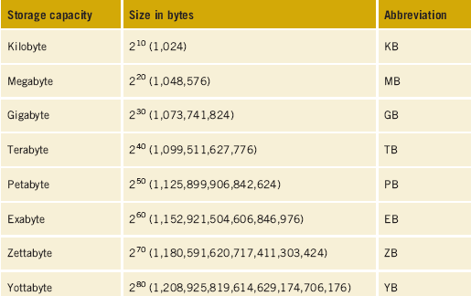
Data Representation (continued)
Table 2-2 Common abbreviations for data representations

Slide 11
Memory Locations for Data
Identifier
Name
Rules for creating an identifier
Combination of alphabetic characters (a-z and A-Z), numeric digits (0-9), and the underscore
First character in the name may not be numeric
No embedded spaces – concatenate (append) words together
Keywords cannot be used
Use the case of the character to your advantage
Be descriptive with meaningful names

Slide 12
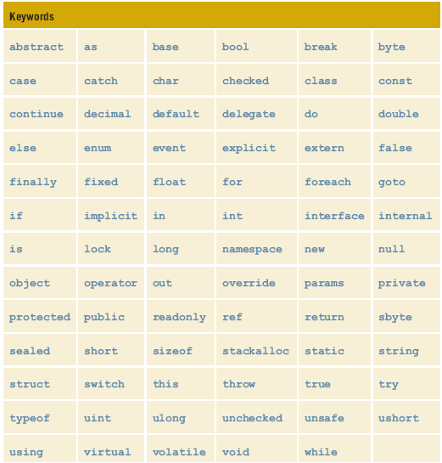
Reserved Words in C#
Table 2-3
C# keywords/
reserved words

Slide 13
Reserved Words in C# (continued)
Contextual keywords
As powerful as regular keywords
Contextual keywords have special meaning only when used in a specific context; other times they can be used as identifiers

Slide 14
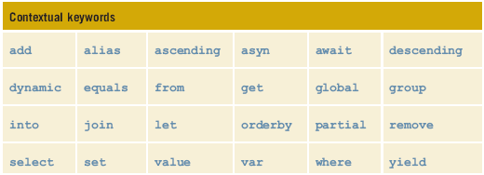
Contextual Keywords
Table 2-4 C# contextual keywords

Slide 15
Naming Conventions
Pascal case
First letter of each word capitalized
Class, method, namespace, and properties identifiers
Camel case
Hungarian notation
First letter of identifier lowercase; first letter of subsequent concatenated words capitalized
Variables and objects

Slide 16
Naming Conventions (continued)
Uppercase
Every character is uppercase
Constant literals and for identifiers that consist of two or fewer letters

Slide 17
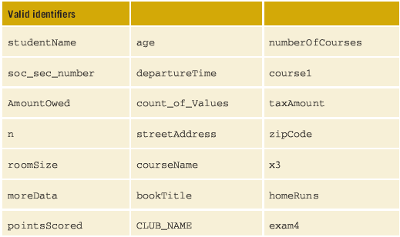
Examples of Valid Names (Identifiers)
Table 2-5 Valid identifiers

Slide 18
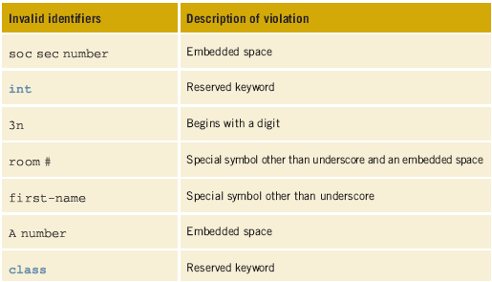
Examples of Invalid Names (Identifiers)
Table 2-6 Invalid identifier

Slide 19
Variables
Area in computer memory where a value of a particular data type can be stored
Declare a variable
Allocate memory
Syntax
type identifier;
Compile-time initialization
Initialize a variable when it is declared
Syntax
type identifier = expression;

Slide 20
Types, Classes, and Objects
Type
C# has more than one type of number
int type is a whole number
Floating-point types can have a fractional portion
Types are actually implemented through classes
One-to-one correspondence between a class and a type
Simple data type such as int, implemented as a class

Slide 21
Types, Classes, and Objects (continued)
Instance of a class → object
A class includes more than just data
Encapsulation → packaging of data and behaviors into a single or unit→class

Slide 22
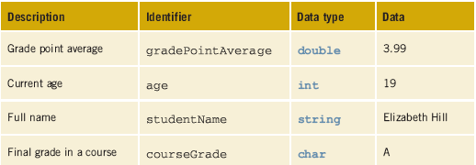
Type, Class, and Object Examples
Table 2-7 Sample data types

Slide 23
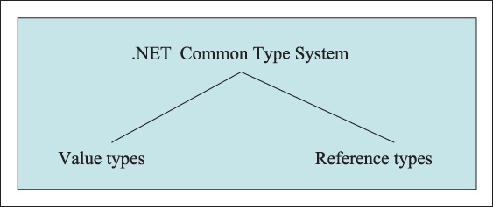
Predefined Data Types
Common Type System (CTS)
Divided into two major categories
Figure 2-3 .NET common types

Slide 24
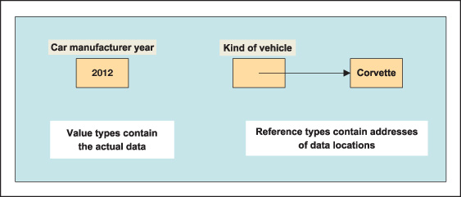
Value and Reference Types
Figure 2-4 Memory representation for value and reference types

Slide 25
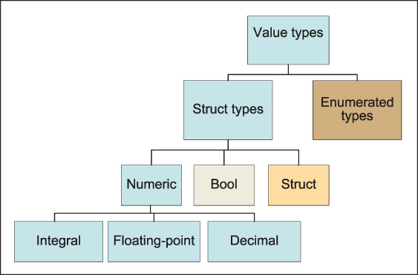
Value Types
Fundamental or primitive data types
Figure 2-5 Value type hierarchy

Slide 26
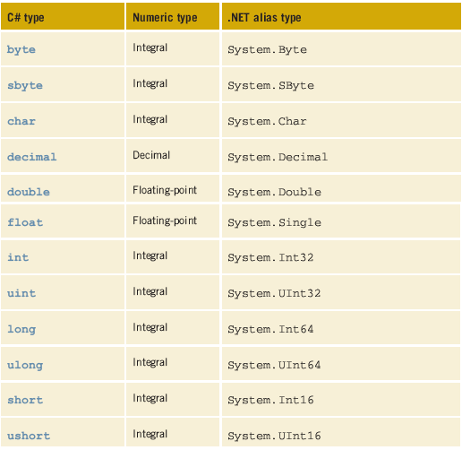
Value Types (continued)
Table 2-8 C# value
data types with
.NET alias

Slide 27
Integral Data Types
Primary difference
How much storage is needed
Whether a negative value can be stored
Includes number of types
byte & sbyte
char
int & uint
long & ulong
short & ushort

Slide 28
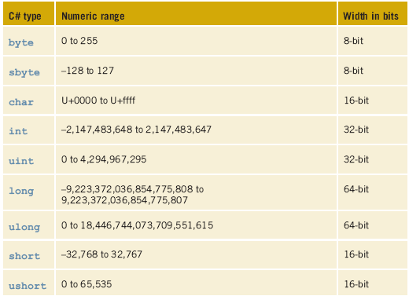
Data Types
Table 2-9 Values and sizes for integral types

Slide 29
Examples of Integral Variable Declarations
int studentCount; // number of students in the class
int ageOfStudent = 20; // age - originally initialized to 20
int numberOfExams; // number of exams
int coursesEnrolled; // number of courses enrolled

Slide 30
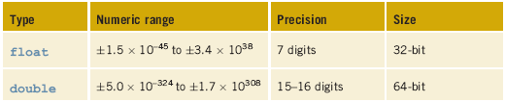
Floating-Point Types
May be in scientific notation with an exponent
n.ne±P
3.2e+5 is equivalent to 320,000
1.76e-3 is equivalent to .00176
OR in standard decimal notation
Default type is double
Table 2-10 Values and sizes for floating-point types

Slide 31
Examples of Floating-Point Declarations
double extraPerson = 3.50; // extraPerson originally set
// to 3.50
double averageScore = 70.0; // averageScore originally set
// to 70.0
double priceOfTicket; // cost of a movie ticket
double gradePointAverage; // grade point average
float totalAmount = 23.57f; // note the f must be placed after
// the value for float types

Slide 32

Decimal Types
Monetary data items
As with the float, must attach the suffix ‘m’ or ‘M’ onto the end of a number to indicate decimal
Float attach ‘f’ or ‘F’
Table 2-11 Value and size for decimal data type
Examples
decimal endowmentAmount = 33897698.26M;
decimal deficit;

Slide 33
Boolean Variables
Based on true/false, on/off logic
Boolean type in C# → bool
Does not accept integer values such as 0, 1, or -1
bool undergraduateStudent;
bool moreData = true;

Slide 34
Strings
Reference type
Represents a string of Unicode characters
string studentName;
string courseName = "Programming I";
string twoLines = "Line1\nLine2";

Slide 35
Making Data Constant
Add the keyword const to a declaration
Value cannot be changed
Standard naming convention
Syntax
const type identifier = expression;
const double TAX_RATE = 0.0675;
const int SPEED = 70;
const char HIGHEST_GRADE = 'A';

Slide 36
Assignment Statements
Used to change the value of the variable
Assignment operator (=)
Syntax
variable = expression;
Expression can be:
Another variable
Compatible literal value
Mathematical equation
Call to a method that returns a compatible value
Combination of one or more items in this list

Slide 37
Examples of Assignment Statements
int numberOfMinutes,
count,
minIntValue;
numberOfMinutes = 45;
count = 0;
minIntValue = -2147483648;

Slide 38
Examples of Assignment Statements
char firstInitial,
yearInSchool,
punctuation;
enterKey,
lastChar;
firstInitial = 'B';
yearInSchool = '1';
punctuation = '; ';
enterKey = '\n'; // newline escape character
lastChar = '\u005A'; // Unicode character 'Z'

Slide 39
Examples of Assignment Statements (continued)
double accountBalance,
weight;
bool isFinished;
accountBalance = 4783.68;
weight = 1.7E-3; //scientific notation may be used
isFinished = false; //declared previously as a bool
//Notice – no quotes used

Slide 40
Examples of Assignment Statements (continued)
decimal amountOwed,
deficitValue;
amountOwed = 3000.50m; // m or M must be suffixed to
// decimal data types
deficitValue = -322888672.50M;

Slide 41
Examples of Assignment Statements (continued)
string aSaying, fileLocation;
aSaying = "First day of the rest of your life!\n";
fileLocation = @ "C:\CSharpProjects\Chapter2";
@ placed before a string literal signals that the characters inside the double quotation marks should be interpreted verbatim --- No need to use escape characters with @

Slide 42
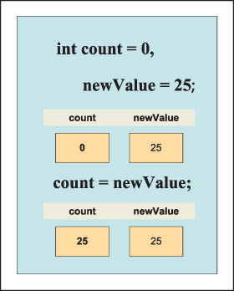
Examples of Assignment Statements (continued)
Figure 2-7 Impact of assignment statement

Slide 43
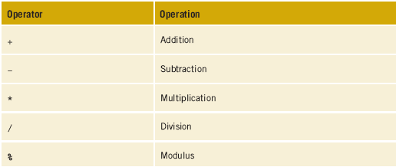
Arithmetic Operations
Simplest form of an assignment statement
resultVariable = operand1 operator operand2;
Readability
Space before and after every operator
Table 2-12 Basic arithmetic operators

Slide 44
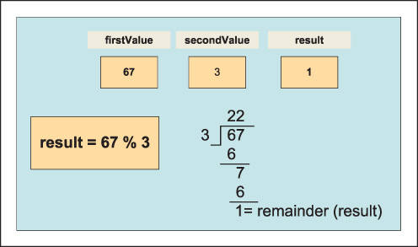
Basic Arithmetic Operations
Figure 2-8 Result of 67 % 3
Modulus operator with negative values
Sign of the dividend determines the result
-3 % 5 = -3; 5 % -3 = 2; -5 % -3 = -3;

Slide 45
Basic Arithmetic Operations (continued)
Plus (+) with string Identifiers
Concatenates operand2 onto end of operand1
string result;
string fullName;
string firstName = "Rochelle";
string lastName = "Howard";
fullName = firstName + " " + lastName;

Slide 46
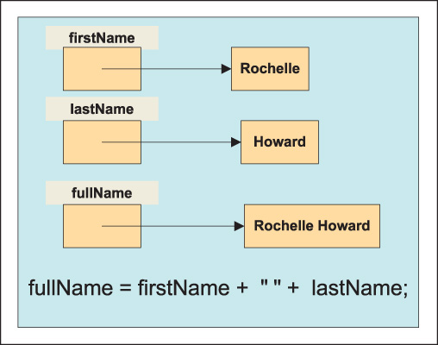
Concatenation
Figure 2-9 String concatenation

Slide 47
Basic Arithmetic Operations (continued)
Increment and Decrement Operations
Unary operator
num++; // num = num + 1;
--value1; // value = value – 1;
Preincrement/predecrement versus post
int num = 100;
Console.WriteLine(num++); // Displays 100
Console.WriteLine(num); // Display 101
Console.WriteLine(++num); // Displays 102

Slide 48
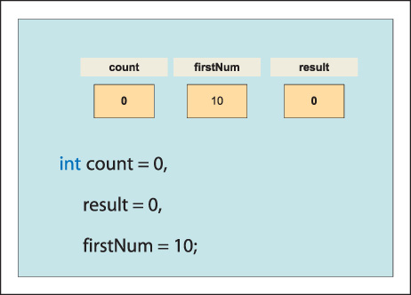
Basic Arithmetic Operations (continued)
Figure 2-10 Declaration of value type variables

Slide 49
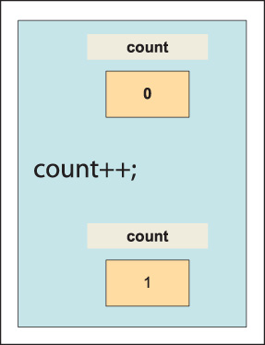
Basic Arithmetic Operations (continued)
Figure 2-11 Change in memory after count++; statement executed

Slide 50
Basic Arithmetic Operations (continued)
int num = 100;
Console.WriteLine(x++ + " " + ++x);
// Displays 100 102

Slide 51
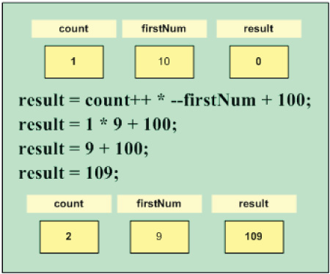
Basic Arithmetic Operations (continued)
Figure 2-12 Results after statement is executed

Slide 52
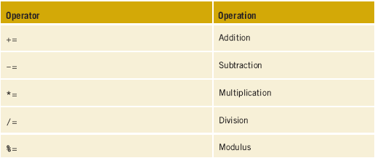
Compound Operations
Accumulation
Variable on left side of equal symbol is used once the entire expression on right is evaluated
Table 2-13 Compound arithmetic operators

Slide 53
Basic Arithmetic Operations (continued)
Order of operations
Order in which the calculations are performed
Example
answer = 100;
answer += 50 * 3 / 25 – 4;
50 * 3 = 150
150 / 25 = 6
6 – 4 = 2
100 + 2 = 102

Slide 54
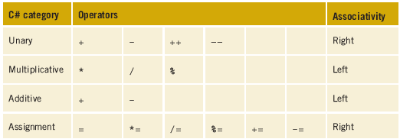
Order of Operations
Table 2-14 Operator precedence
Associatively of operators
Left
Right

Slide 55
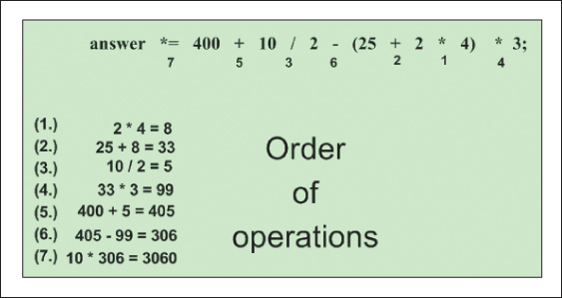
Order of Operations (continued)
Figure 2-13 Order of execution of the operators

Slide 56
Mixed Expressions
Implicit type coercion
Changes int data type into a double
No implicit conversion from double to int
double answer;
answer = 10 / 3; // Does not produce 3.3333333
int value1 = 440,
anotherNumber = 70;
double value2 = 100.60;
value2 = value1; // ok here – 440.0 stored in value2

Slide 57
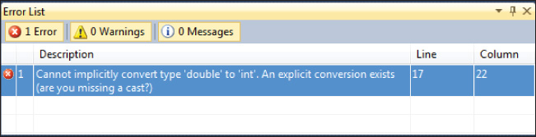
Mixed Expressions
int value1 = 440;
double value2 = 100.60;
value1 = value2; // syntax error as shown in Figure 2-14
Figure 2-14 Syntax error generated for assigning a double to
an int

Slide 58
Mixed Expressions (continued)
Explicit type coercion
Cast
(type) expression
examAverage = (exam1 + exam2 + exam3) / (double) count;
int value1 = 0,
anotherNumber = 75;
double value2 = 100.99,
anotherDouble = 100;
value1 = (int) value2; // value1 = 100
value2 = (double) anotherNumber; // value2 = 75.0

Slide 59
Formatting Output
You can format data by adding dollar signs, percent symbols, and/or commas to separate digits
You can suppress leading zeros
You can pad a value with special characters
Place characters to the left or right of the significant digits
Use format specifiers

Slide 60
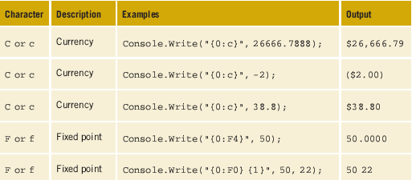
Formatting Output (continued)
Table 2-15 Examples using format specifiers

Slide 61
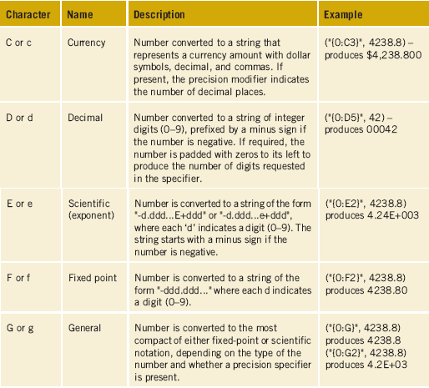
Numeric Format Specifiers
Table 2-16 Standard numeric format specifiers

Slide 62
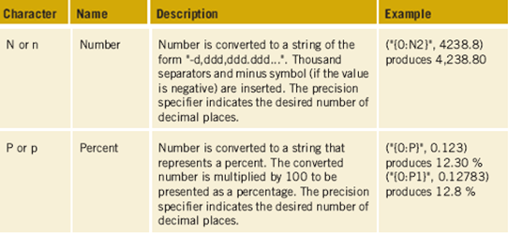
Numeric Format Specifiers (continued)
Table 2-16 Standard numeric format specifiers (continued)

Slide 63
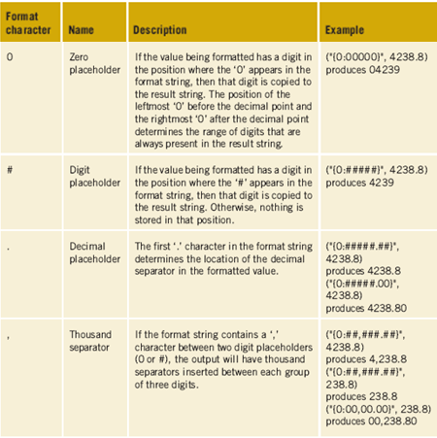
Custom Numeric Format Specifiers
Table 2-17 Custom numeric format specifiers

Slide 64
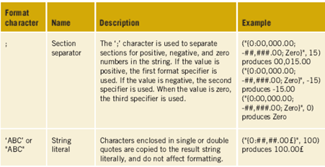
Custom Numeric Format Specifiers (continued)
Table 2-17 Custom numeric format specifiers (continued)

Slide 65
Width Specifier
Useful when you want to control the alignment of items on multiple lines
Alignment component goes after the index ordinal followed by a comma (before the colon)
If alignment number is less than actual size, it is ignored
If alignment number is greater, pads with white space
Negative alignment component places spaces on right
Console.WriteLine("{0,10:F0}{1,8:C}", 9, 14);
9 $14.00 //Right justifies values

Slide 66
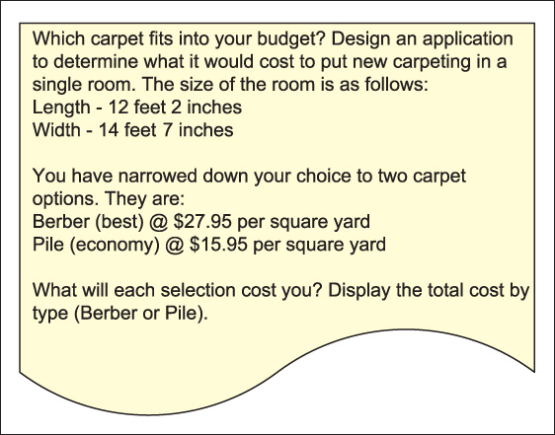
Programming Example – CarpetCalculator
Figure 2-15 Problem specification sheet for the
CarpetCalculator example

Slide 67
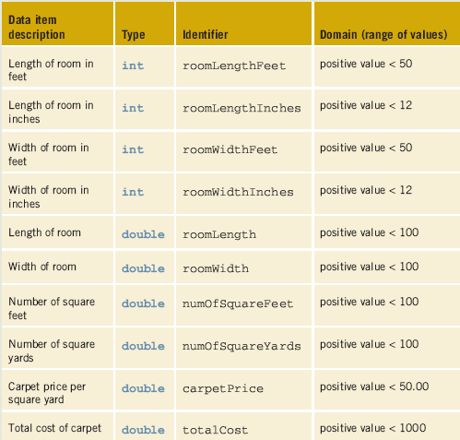
Data Needs for the CarpetCalculator
Table 2-18 Variables

Slide 68
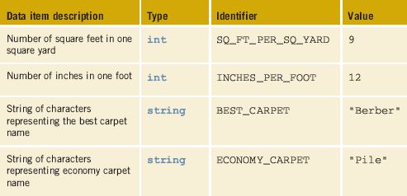
Nonchanging Definitions for the CarpetCalculator
Table 2-19 Constants

Slide 69
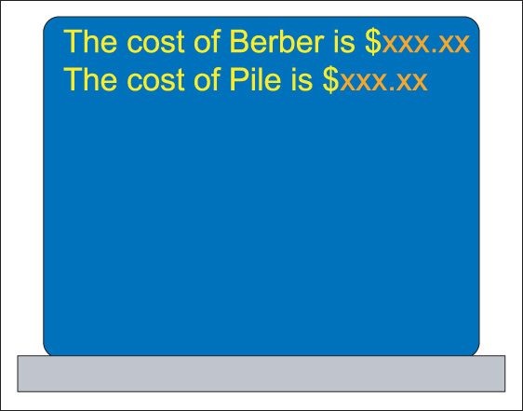
CarpetCalculator Example
Figure 2-16 Prototype for the CarpetCalculator example

Slide 70
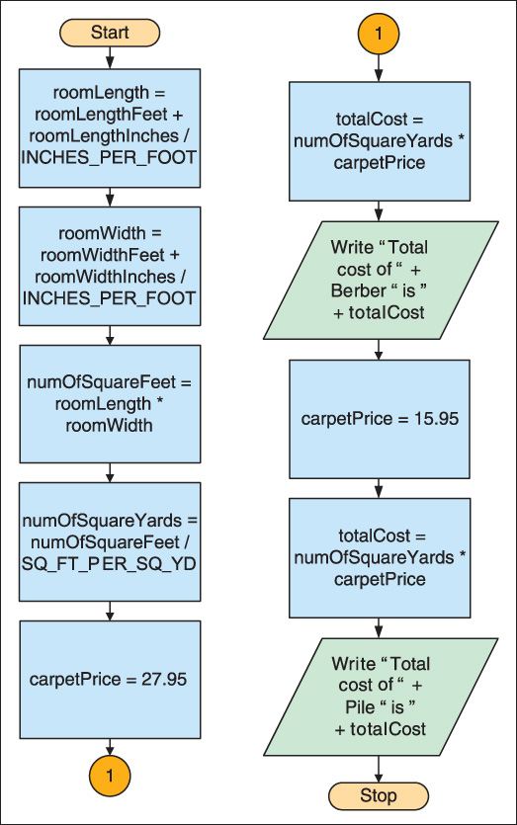
Algorithm for CarpetCalculator Example
Figure 2-17 CarpetCalculator flowchart

Slide 71
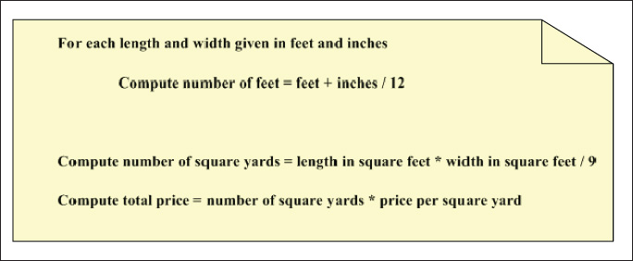
Algorithm for the CarpetCalculator Example (continued)
Figure 2-18 Structured English for the CarpetCalculator example

Slide 72
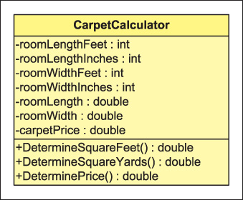
CarpetCalculator Example (continued)
Figure 2-19 Class diagram for the CarpetCalculator example

Slide 73
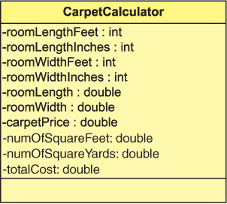
CarpetCalculator Example (continued)
Figure 2-20 Revised class diagram without methods

Slide 74
/* CarpetCalculator.cs Author: Doyle
*/
using System;
namespace CarpetExample
{
class CarpetCalculator
{
static void Main( )
{
const int SQ_FT_PER_SQ_YARD = 9;
const int INCHES_PER_FOOT = 12;
const string BEST_CARPET = "Berber";
const string ECONOMY_CARPET = "Pile";
int roomLengthFeet = 12, roomLengthInches = 2,
roomWidthFeet = 14, roomWidthInches = 7;
double roomLength, roomWidth, carpetPrice,
numOfSquareFeet,
numOfSquareYards, totalCost;

Slide 75
roomLength = roomLengthFeet +
(double) roomLengthInches / INCHES_PER_FOOT;
roomWidth = roomWidthFeet +
(double) roomWidthInches / INCHES_PER_FOOT;
numOfSquareFeet = roomLength * roomWidth;
numOfSquareYards = numOfSquareFeet /
SQ_FT_PER_SQ_YARD;
carpetPrice = 27.95;
totalCost = numOfSquareYards * carpetPrice;
Console.WriteLine("The cost of " + BEST_CARPET
+ " is {0:C}", totalCost);
Console.WriteLine( );
carpetPrice = 15.95;
totalCost = numOfSquareYards * carpetPrice;
Console.WriteLine("The cost of " +
ECONOMY_CARPET
+ " is " + "{0:C}", totalCost);
Console.Read();
} } }

Slide 76
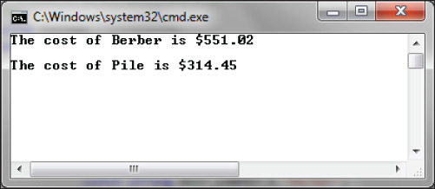
CarpetCalculator Example (continued)
Figure 2-21 Output from the CarpetCalculator program

Slide 77
Coding Standards
Naming conventions
Identifiers
Spacing conventions
Declaration conventions

Slide 78
Resources
Naming Guidelines for .NET –
http://msdn.microsoft.com/en-us/library/xzf533w0(VS.71).aspx
Writing Readable Code – http://software.ac.uk/resources/guides/writing-readable-source-code#node-131
C# Video tutorials – http://www.programmingvideotutorials.com/csharp/csharp-introduction Visual Studio 2012 – C# –
http://msdn.microsoft.com/en-us/library/kx37x362(V=VS.110).aspx

Slide 79
Chapter Summary
Memory representation of data
Bits versus bytes
Number system
Binary number system
Character sets
Unicode

Slide 80
Chapter Summary (continued)
Memory locations for data
Relationship between classes, objects, and types
Predefined data types
Integral data types
Floating-point types
Decimal type
Boolean variables
Strings

Slide 81
Chapter Summary (continued)
Constants
Assignment statements
Order of operations
Formatting output

